Slide 1
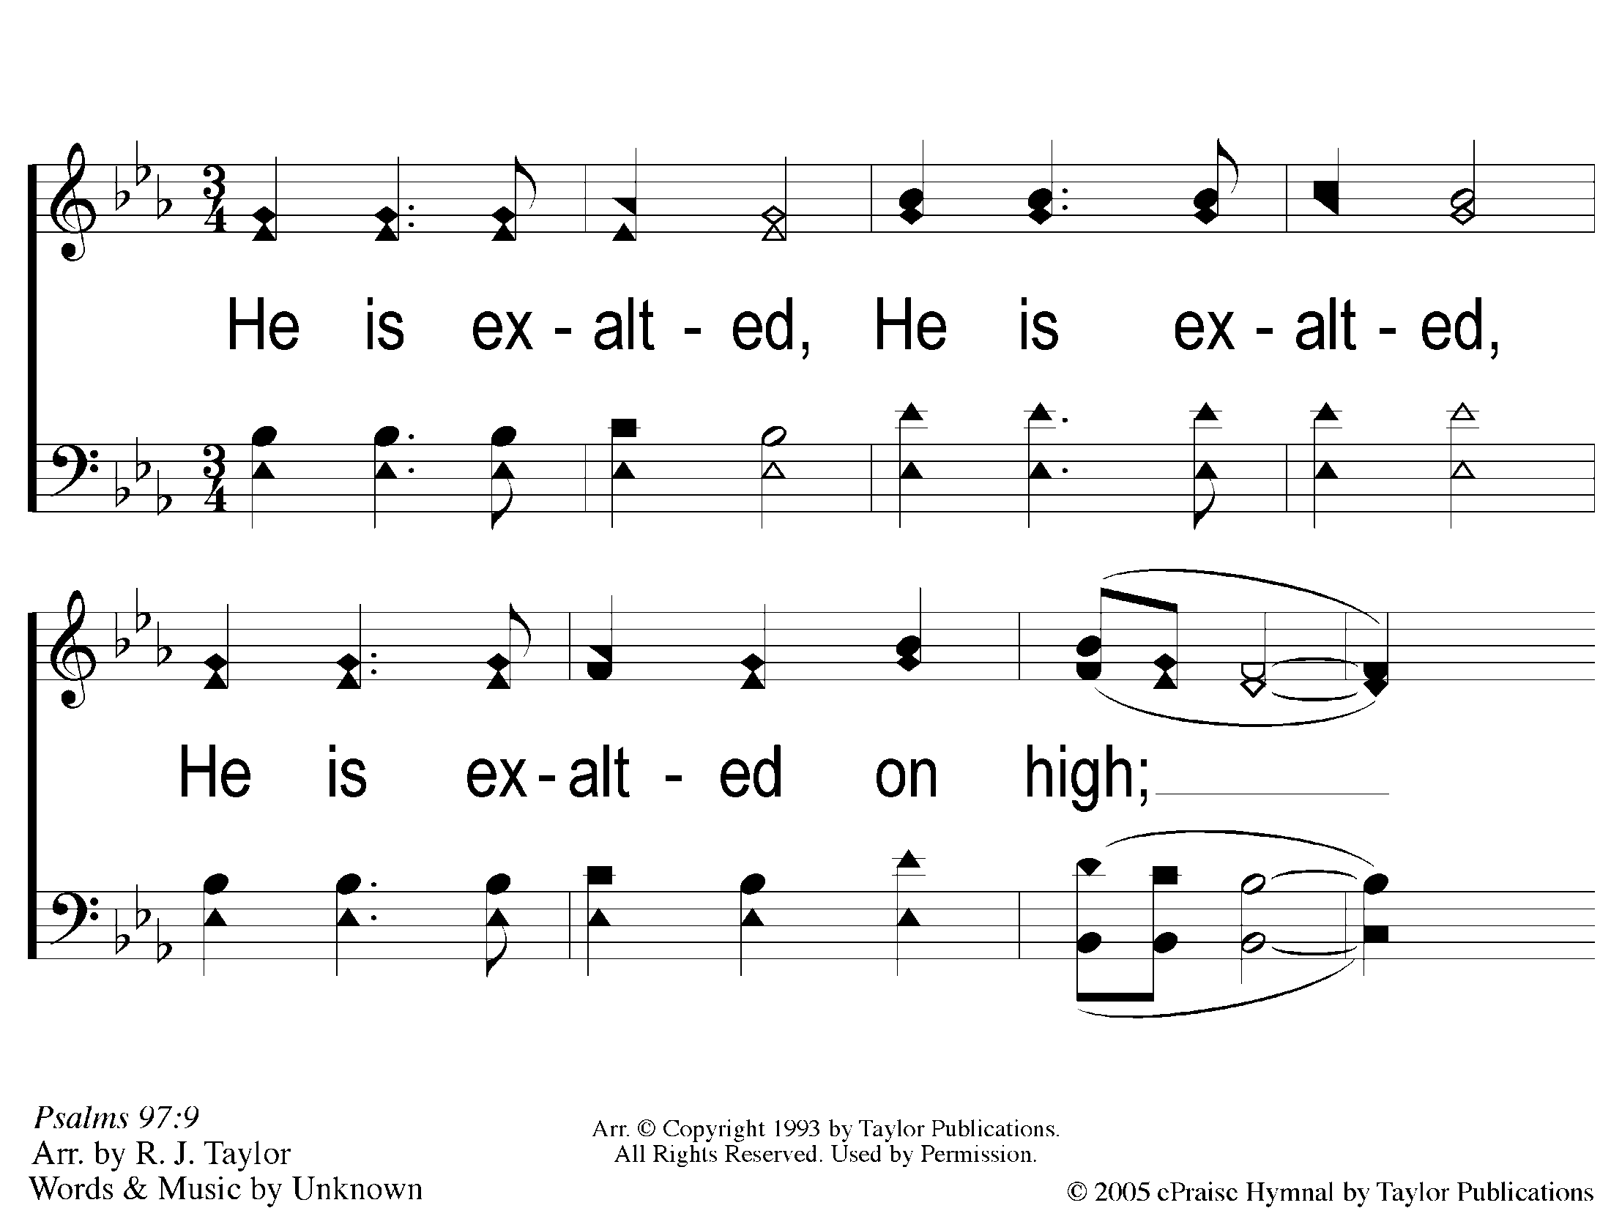
1 He is Exalted
He Is Exalted

Slide 2
2 He is Exalted
He Is Exalted

